Slide 1
The Relationship between Masculinity Traits and Men’s Health Behaviors: A Literature Review
Empirical studies consistently show that men are more likely than women to engage in nearly every single health risk behavior (e.g., alcohol use, tobacco use, not seeking medical care) increasing their risk of injury, disease, and death (Courtenay, 2000)
Researchers suggest that socialization of male gender roles contributes to higher frequencies of health risk behaviors and poor health outcomes (Courtenay, 2001)
Purpose:
This literature review includes an investigation of various masculine traits and their relationship to men’s engagement in healthy lifestyle practices and risky health behaviors
Materials and Methods
A literature review of studies examining the relationship of masculinity traits to men’s health behaviors was conducted using PsycINFO, PubMed, PsycArticles, and PsycTest databases
Search terms used were:
Masculinity and machismo
Men’s health risk
Men’s health behavior
Underserved population
All articles considered were published between 2000 and 2019
All articles were peer-reviewed
Articles that examined the significant influence of masculinity traits on health behaviors in men were retained for this study
Notes:
Time per slide: slide1- 60s, slide2 - 35s, slide3 - 45s, slide4 - 10s

Slide 2
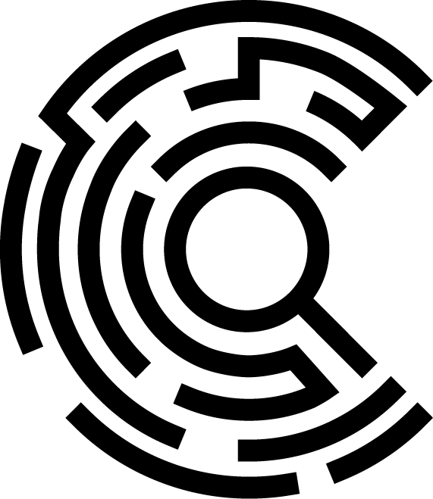
Results
Thirty-one articles were identified, listing 6 different inventories of masculine traits. Across the different inventories, 15 unique masculinity constructs were assessed
Table 1: Masculinity Inventories Identified in the Literature Review
Inventories | Author
Conformity to Masculine Norms Inventory (CMNI) | Mahalik et al., 2003
Masculine Behavior Scale (MBS) | Snell., 1989
Male Role Norms Inventory-Revised (MRNI-R) | Levant F et al., 2007
Male Role Norms Inventory-Short Form (MRNI-SF) | Levant F et al., 2013
Masculinity in Chronic Disease Inventory (MCDI) | Chambers et al, 2016
Auburn Differential Masculinity Inventory (ADMI) | Burk et al., 2004
Masculine Attributes Questionnaire (MAQ) | Cho & Kogan, 2017
Table 2: Masculinity constructs that significantly predict risk behaviors
Risk Behaviors | Masculinity constructs predicting high risk behaviors | Masculinity constructs predicting low risk behaviors
Substance used | Dominance^{3, 8, 9, 10, 11, 12} Sexual Importance^{3, 7, 10, 11} Emotional Control^{4, 7, 8, 10, 11} | Winning^{3, 4, 7, 10}
Anger and stress | Dominance^{3, 8, 9, 10, 11, 12} Self-Reliance^{3, 4, 9, 10, 11} | Primacy of Work^{3, 10} Emotional Control^{4, 7, 8, 10, 11}
Four masculinity constructs predicted high engagement in risky behaviors (dominance, sexual importance, emotional control, self-reliance).
Three masculinity constructs predicted low engagement in risky behaviors (winning, primacy of work, emotional control).
Note: Constructs listed in bold positively and negatively predict risk behaviors

Slide 3
Table 3: Masculinity constructs that significantly predict healthy behaviors
Health Behavior | Masculinity constructs predicting low healthy behavior | Masculinity constructs predicting high healthy behavior
Positive attitudes toward colorectal cancer screening | Bias Against Sexual Minorities ^{3, 10, 11} | None
Preventive self-care | Dominance^{3, 8, 9, 10, 11, 12} | Primacy of Work^{3, 10}
Healthy Behavior Inventory (total score with risk behavior items reverse coded) | Sexual importance^{3, 7, 10, 11} Risk taking^{3, 10, 11, 12} Emotional Control^{4, 7, 8, 10, 11} | Winning^{3, 4, 7, 10}
Global Physical Health | Emotional Control^{4, 7, 8, 10, 11} | None
Global Mental Health | Emotional Control^{4, 7, 8, 10, 11} Sexual Importance^{3, 7, 10, 11} Optimistic Capacity⁷ | Action Approach⁷
 | Emotional Control^{4, 7, 8, 10, 11} | Self-Reliance^{3, 4, 9, 10, 11}
Mental Health-Related Quality of Life (MCS)
Physical Health-Related Quality of Life (PCS) | Emotional Control^{4, 7, 8, 10, 11} | None
Sexual help-seeking behavior, and less | None | Strength⁷
Note: Constructs listed in bold positively and negatively predict risk behaviors
Six masculinity constructs predicted low engagement in healthy lifestyle
Five masculinity construct predicted high engagement in healthy lifestyle
Two masculinity constructs predicted both healthy and unhealthy behaviors (emotional control and self-reliance)
Discussion: Although the literature typically portrays masculine traits as having negative influence on men’s health behavior, these findings suggest that masculine traits can predict both positive and negative health behaviors in men. These findings can help direct the development of cancer prevention interventions for men.
Notes:
Six masculinity constructs predicted low engagement in healthy lifestyle (Bias against sexual minority, dominance, sexual importance, risk taking, emotional control, and optimistic capacity).
Five masculinity construct predicted high engagement in healthy life style (Primacy of work, winning, action approach, self-reliance, and strength).
Four either have not been tested or found to predict behavior (Hypermasculinity, Conservative Masculinity, Reputation, Responsibilities/Family)

Slide 4
Funding
Partnership for the Advancement of Cancer Research, supported in part by NCI grants U54 CA132383 (NMSU) and U54 CA132381 (Fred Hutch).
For more information contact:
Bidemi Adedokun, MSc
bidemi@nmsu.edu
cancer.nmsu.edu

