Slide 1
Postpartum Women’s Weight Changes in Group and Individual Nurse-Midwifery Care: A Pilot Study in Rural New Mexico
Kim J. Cox, PhD, CNM, Principal Investigator
Ambroshia M. Murrietta, MHS, Community Research Specialist
Carla N. Roybal, MPH, Community Research Specialist

Slide 2
Background
Weight gained during pregnancy is often retained indefinitely
Few interventions for postpartum weight loss
Rural dwelling women have a higher prevalence of
Sedentary lifestyle
Obesity
Diabetes

Slide 3
Background
Individual or usual care:
One provider and one patient
Short, episodic visits
Varies by provider

Slide 4
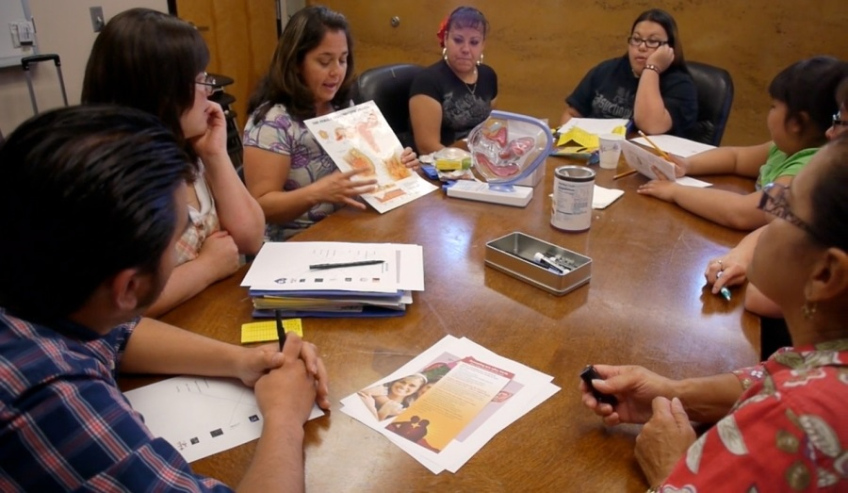
Background
Group care:
Group leader (provider and community health worker) and multiple participants
May include other family members
Consistent evidence-based teaching
Group interaction

Slide 5
Research Questions
Do women in a group model of CNM care lose more weight and have leaner body mass in the first 6 months postpartum than women in an individual model of CNM care?
Compare postpartum weight and body composition changes from 2 weeks to 6 months postpartum among women in group and individual CNM care
Compare women’s postpartum weight loss as a proportion of total pregnancy weight gain
From women’s perspectives, what were the barriers and facilitators that helped them lose weight (or not) in the first 6 months postpartum?

Slide 6
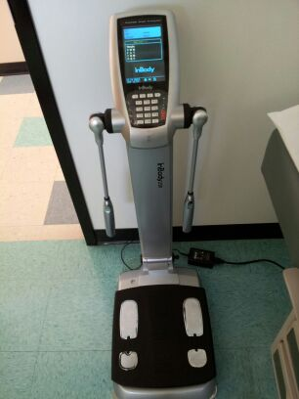
Design
Mixed Methods pilot study
April 1, 2012 - March 31, 2013
Quasi-experimental QUANT phase:
2 groups of low-income women
Recruitment (N=27)
2 weeks PP (N=19)
6 months PP (N=14)
Data Collection
Weight and body composition measures using the InBody at 2 wks. and 6 mos. PP
Edinburgh Postpartum Depression Scale (EPDS) - 2 wks./ 6 mos.
Modifiable Activity Questionnaire (MAQ) - 6 mos. PP

Slide 7
Design
Qualitative interviews with both groups (N=13)
Conducted in person or by phone at 6 mos.
Audio recorded and transcribed verbatim
Thematic content analysis

Slide 8
Setting & Sample
Family Health Partnerships (Bernalillo, NM)
CoN faculty practice offering group care for pregnancy and through the first postpartum year
CHW outreach
University Midwifery Associates (Albuquerque, NM)
Women with rural home address
Individual care which ends at 6 weeks postpartum

Slide 9
Quantitative Results
Pregnancy and postpartum weight changes
 | Group Care |  |  | Individual Care |  |  | P-value¹
 | n | Median (Q1-Q3) | Min-Max | n | Median (Q1-Q3) | Min-Max
Total pregnancy weight gain (pounds) | 9 | 37.0 (29.9, 60.9) | 5.1, 66.9 | 5 | 49.7 (29.9, 60.9) | 16.3, 67.1 | NS
Weight loss (pounds) from birth to 6 mos. postpartum | 9 | 30.6 (15.8, 30.4) | 7.3, 40.0 | 5 | 30.4 (24.4, 35.6) | 22.9, 52.6 | NS
Percent of pregnancy weight gain retained at 6 mos. postpartum | 9 | 8.0 (4.0, 15.0) | -7.0, 24.0 | 5 | 6.0 (-4.0, 19.0) | -4.0, 29.0 | NS

Slide 10
Quantitative Results
Breastfeed and postpartum weight changes
 | Group Care | Individual Care | P-value¹
 | N (%) | N (%)
Breastfeeding at 2 weeks postpartum
Exclusive breastfeeding | 7(77.8) | 8(80.0) | NS NS
Breastfeeding with supplement | 2(22.2) | 2(20.0)
Quantity of supplements
1-2 times/day | 0(0.0) | 1(50.0)
3-5 times/day | 1(50.0) | 1(50.0)
6-10 times/day | 1(50.0) | 0(0.0)
Breastfeeding at 6 months postpartum
Exclusive breastfeeding | 3(33.3) | 5(100.0) | 0.05
Breastfeeding with supplement | 1(11.1) | 0(0.0)
Not breastfeeding | 5(55.6) | 0(0.0)
Quantity of supplements
1-2 times/day | 0(0.0) | 0(0.0)
3-5 times/day | 1(100.0) | 0(0.0)
6-10 times/day | 0(0.0) | 0(0.0)

Slide 11
Quantitative Findings
There were no significant differences between groups for weight and body composition changes, weight retention or activity levels
Most women retained 6-8% of the weight they gained during pregnancy through 6 months postpartum
Women in the individual care group were significantly more likely to be exclusively breastfeeding at 6 months postpartum than women in group care ( p=0.05)

Slide 12
Qualitative Findings
Two primary themes emerged from the interview data:
Limited time and resources to manage weight
Challenges to maintaining exclusive breastfeeding

Slide 13
Qualitative Findings
The majority of women in the study returned to work by the 6-month interview, so there was a challenge of having the time to cook nutritious meals at home.

Slide 14
Qualitative Findings
“By the time both of us get home, it’s like ‘who’s closer to pick something up?’ So at least those three nights a week, we’re usually eating out or getting take out.”

Slide 15
Qualitative Findings
Rural residency limited some women’s options for regular physical activity.
“I live in the mountains so I can’t run up and down the streets, or else I’ll be chased by all these stray dogs.”

Slide 16
Qualitative Findings
“There’s always more opportunity in [the city]. Like water aerobics…there’s no indoor pool in my town. They do have yoga classes but none that meet the needs of a stay at home mom.”

Slide 17
Qualitative Findings
Cultural dietary traditions and family influences played a part in how well women were able to incorporate their knowledge of healthy eating into meal planning and food preparation.

Slide 18
Qualitative Findings
“Before I was pregnant, and not dependent on anybody else for financial reasons, I could go and get whatever I wanted from Whole Foods…but just being home, being so dependent on my mom, it just makes me feel like I can’t do that to her because they’re her groceries, too, and she doesn’t like that stuff at all. She’s totally traditional.”
“[My husband’s] idea of healthy is so skewed…it does not mean you put lettuce on your burrito and now it’s healthy.”

Slide 19
Qualitative Findings
Desire to breastfeed
Benefits for their babies
“I love breastfeeding. It’s so good for her and its really good bonding. I think it helped a lot with postpartum and all the emotional changes and everything. It’s definitely helped.”

Slide 20
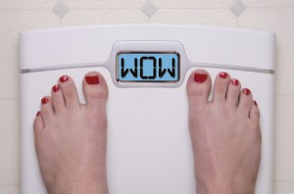
Qualitative Findings
Desire to breastfeed
Benefits for themselves
“My first pregnancy I didn’t breast feed that long, like now he’s gonna be six months, I breast fed this whole time, and I think I lost more weight than I did with my first.”

Slide 21
Qualitative Findings
It’s not so much that women didn’t want to breastfeed, it’s that they couldn’t breastfeed

Slide 22
Qualitative Findings
Inadequate milk supply
“My boss had promised me that I could [breastfeed], but it just seemed that they never really gave me time to do that . . . I would actually still be breastfeeding now had it all worked accordingly.”
"I’m breastfeeding, but at the same time I’m not keeping to my breast pump schedule so I started to lose milk. You just…you start drying up and I just felt that it was easier for me to get her on formula."

Slide 23
Qualitative Findings
Returning to work very quickly after the baby’s birth
“For about, like three weeks, that was it. Because I went back to work right away, I kind of had to. I went back part time at about four and a half weeks, and then I went back full time when she was about eight weeks. So, I had to go back right away.”

Slide 24
Limitations
Despite incentives and retention efforts, there was a high rate of dropout (71%) in the individual care group; however, dropout was low (10%) for women in group care
Interpretation of the quantitative results is limited by the small sample size and the potential for sampling bias, particularly in the individual care group

Slide 25
Questions?

